Slide 1
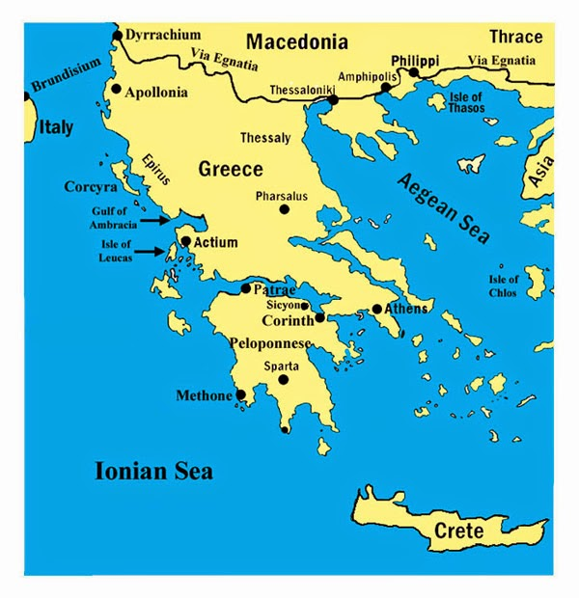
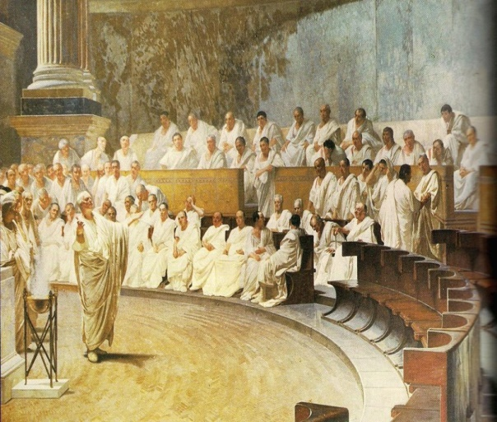
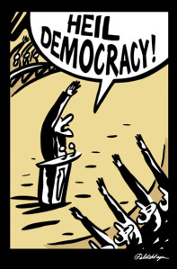
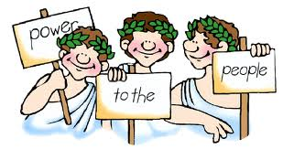
Origins of democracy
Athens, 5th century BC

Slide 2
DEMOCRACY: is a word that comes from the Ancient Greek word Dèmos which means people and Kratos that means power; it’s a system of government in which the citizens exercise power and/or elect representatives from among themselves.

Slide 3
Democracy developed around the fifth century B.C. in the city-state of Athens in Pericles’ leadership. During that period there was Cleisthenes who assumed an important role thanks to isonomy and ostricism.
Isonomy same rights and duties in front of the law
Ostricism it was a procedure in which a citizen could have been expelled for 10 years if considered dangerous.

Slide 4
How did democracy work in athens?
It was a direct democracy
Only men and soldiers born in Athens could vote
Society was divided into 10 tribes based on location, they elected the people who formed the Council
VOTE: act in which a person manifests his own will and choice in electing someone.

Slide 5
Athenian assemblies
In Athens the assembly was called Ekklesia. They were held every 10 days and the Council was made by over 500 people.
Assemblies’ powers were divided into:
Legislative power: they used to make laws
Contacts abroad: they used to decide alliances, war strategies and peace
Judiciary power: there were magistrates who worked in tribunals applying the Isonomy

Slide 6
Every citizen could speak because everybody had the same rights
How was Ekklesia
ruled?
The counting of votes was secret
To be part of assemblies, it was necessary to be an Athenian citizen and 18 years old

Slide 7
Pericles’ leadership
GOLDEN AGE
He guided the citizens during the Peloponnesian war
He was a good orator, and he’s considered the greatest example of a democratic Athens.
He supported the developement of arts and literature
He indroduced a salary for politicians and war trices
He offered jobs for artisans and peasants

Slide 8
The idea of democracy
Differencies:
There was only the direct democracy
In the past
The power wasn’t divided
Only a few people could vote

Slide 9
The vote is almost universal
Today
Our kind of democracy is the representative one
The power is divided

Slide 10
similarities:
The freedom of speech in society, in fact the Isegoria was the base of the society
The idea that politics is a common thing, for everyone

Slide 11
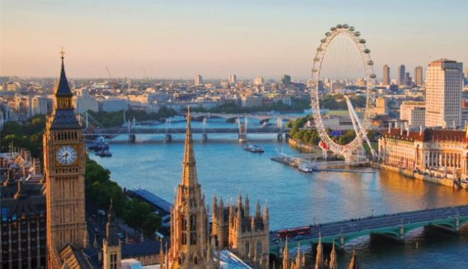
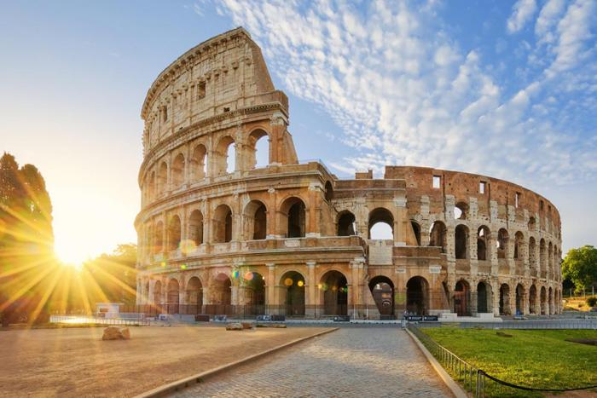
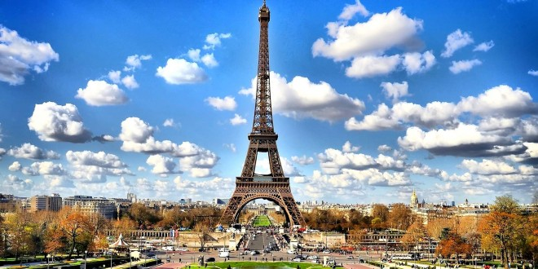
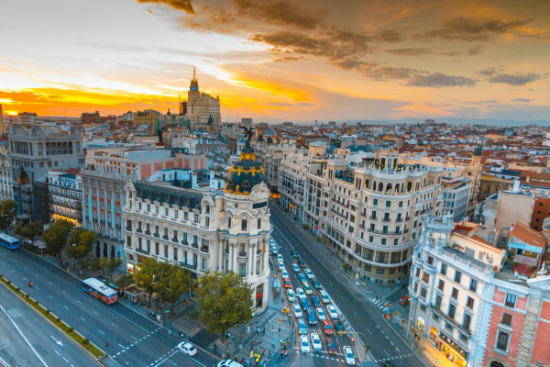
Origin of democracy in Great Britain, Italy, France and Spain.

Slide 12
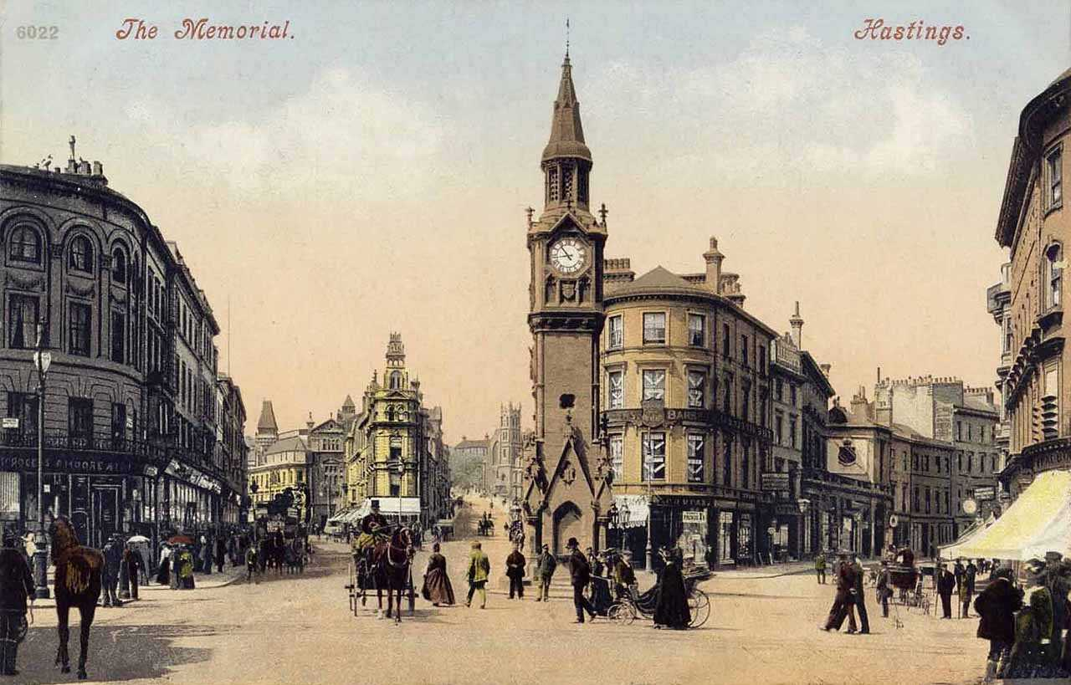
GREAT BRITAIN
1215 : Magna Charta
1707 : Great Britain
1800: Union with Ireland
1918: Representation of people act
First example of State Paliament
Union between Wales, Scotland and England
Recognition of women’s vote. It’s the first time that women have voted in this country

Slide 13
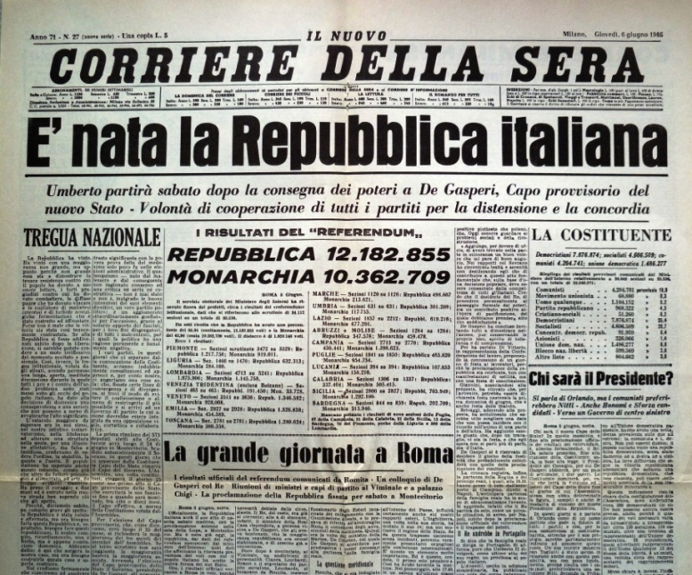
ITALY
Referendum of 2th and 3th June 1946
1th January 1948
It’s the first time that women vote too
The new Italian constitution becomes effective
Photo of the front-page
of an italian famous journal,
the day that Republic began:

Slide 14
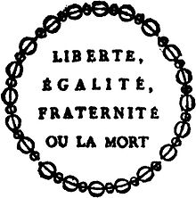
FRANCE
Middle Ages : Monarchy
September 1792 : it’s declared the Republic
Slogan of the French Revolution:
Since then there have been 5 Republics

Slide 15
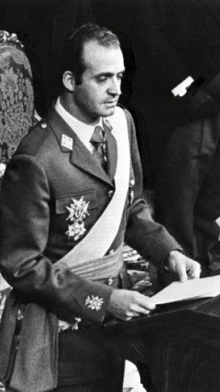
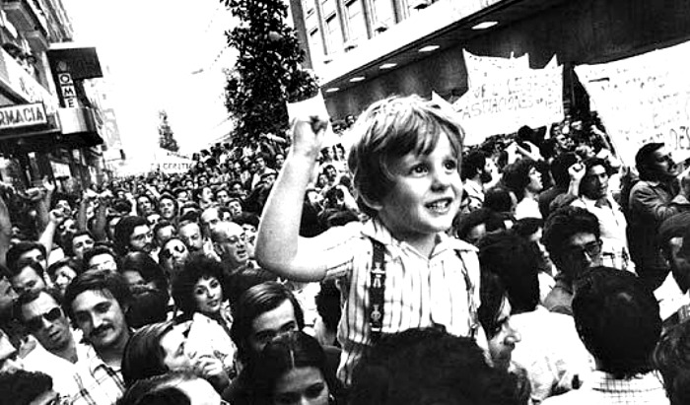
SPAIN
20th November 1975
Spanish Transition:
The dictator Francisco Franco died and the king Juan Carlos was crowned
Period that will bring to a democratic govern although there is Monarchy
Photo of a march towards Democracy in Spain
King Juan Carlos in his first speech

Slide 16
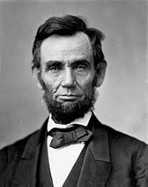
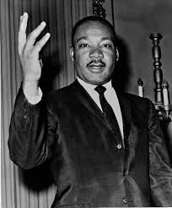
Quotes
“Democracy is the government of the people, by the people, for the people.” -Abraham Lincoln
“Let us not seek to satisfy our thirst for freedom by drinking from the cup of bitterness and hatred. “
― Martin Luther King Jr.
Thank you.
-Martina Gangi

